Slide 1

Spotify Analysis – Song Popularity Prediction
Presented By:
Tanmay Shrivastava
Shruthi Ramesh
Ayush Madaan
Ryan Brinkman

Slide 2
Spotify Background
Spotify is an audio streaming service with 345 million active monthly users
Offers podcasts and recorded music
2 million podcast titles and 70 million songs
Free with ads but offers premium option – 155 million premium subscribers
Available in 178 Worldwide markets
Estimated market share of 32%
Spotify had a 2020 revenue of $10.8 billion (operating loss of $581 million)
Partnership with Amazon and Facebook

Slide 3
Datasets
Spotify offers data access through API
Contains information on tracks, artists, and albums
A Spotify API user uploaded Spotify datasets to Kaggle
Datasets contain information on songs from 1921 and 2021
The data was exported in 4 datasets
1 dataset grouped by song title - 174k+ songs
1 dataset grouped by genre – 3k+ genres
1 dataset grouped by artist - 32k+ artists
1 dataset grouped by year – 102 years
Each of these contain 13 common variables while some contain more variables
Will only use dataset grouped by song title

Slide 4
Common Variables
Acousticness – 0 to 1.0 scale, 1.0 most acoustic
Danceability – 0 to 1.0 scale, 1.0 most danceable
Based on tempo, rhythm, beat strength, and regularity
Energy – 0 to 1.0 scale, 1.0 highest energy
Based on dynamic range, perceived loudness, timbre, onset rate, and entropy
Instrumentalness – 0 to 1.0 scale, 1.0 most instrumental - no words
Liveness – 0 to 1.0 scale, 1.0 most noticeable audience presence
Speechiness – 0 to 1.0 scale, 1.0 only spoken words
Valence – 0 to 1.0 scale – 1.0 being a positive track
Duration_ms – milliseconds
Loudness – decibels
Tempo – beats per minute
Mode – modality of track – 1.0 is major sale and 0.0 is minor scale
Key – 0 to 11 - pitch class notation
Popularity – 0 to 100.0 scale – 100.0 most popular
Based on total number plays and how recent those plays occurred
Gray = 0 to 1 scale – 1.0 being highest point of the variable

Slide 5
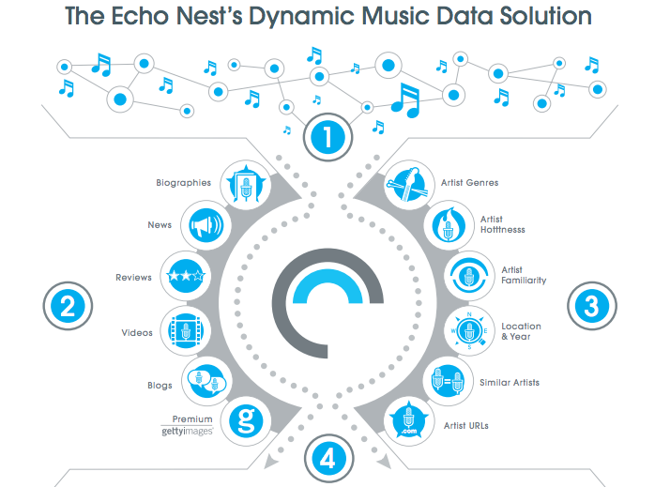

Variable Creation & Echo Nest
Some of the variables in the dataset are numerical representation of a subjective concept
Created by developers at the Echo Nest
The Echo Nest is a music intelligence and data platform
Echo Nest evolved from dissertation work of MIT Media Lab students
Spotify purchased the Echo Nest for $100 million in 2014

Slide 6
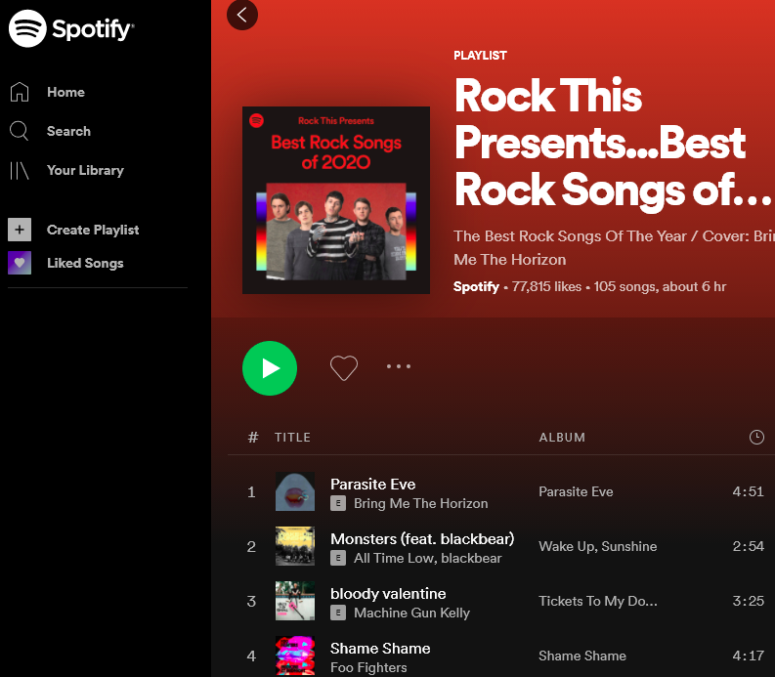
Goals of the Analysis
Determine if the popularity of a song can be estimated using different parameters in the datasets
Python, SQL, and Excel will be used for the analysis

Slide 7
Exploratory Data Analysis
First step was to understand dataset. We focused on:
Completeness – No missing data
Consistency – Data is recorded in a similar manner
Meaningful – The values provide useful insight
Entity Integrity – No repeat values

Slide 8
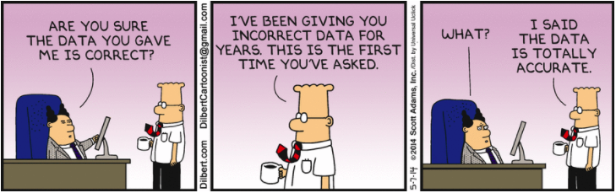
Initial examination performed in SQL to determine if dataset was appropriate for the project
Although 4 datasets uploaded, only 1 used – songs grouped by title
The other datasets used the average values in that particular group
Average key variable is meaningless as the key variable is based on a 0-11 scale with associated tonal counterparts
One hit wonders skew the results
Despite only being credited with 22 songs combined, 24kGoldn and Iann Dior are listed as most popular artist for a collaboration song
Chinese Electropop, Korean Mask Singer, Dutch Rap Pop are listed as the three most genre despite only one artist being credited in each genre
The dataset grouped by song will be the only dataset examined
Grouping done manually if desired

Slide 9
Foreign characters are not translated correctly (non-Unicode)
Michael Bublé is Michael BublÃ©
Turkish Mehmet Kemiksiz’s song is Ey BÃ¼lbÃ¼l-i Ter ZebÃ¢n-i Ä°rf
Inconsistent year referencing
The most popular song in 1956 is Frank Sinatra’s “I've Got You Under My Skin - Remastered 1998”
The most popular song in 2010 is John Lennon’s and Yoko Ono’s “Happy Xmas (War Is Over) - Remastered 2010”
Multiple versions of songs
Original Album / Extended Instrument / Live – Okay
Original Album / Greatest Hits Album / Compilation Album – Unnecessary
3 similar entries of Eagle’s Hotel California with different years
4 completely similar entries of Nirvana’s Smells like Teen Spirit
No featured artist column
45 different combinations where Jay-Z is the primary artist and has at least a featured artist, 35 entries where he is the second artist.
Some data may be too specific
Is 100 jazz categories too much? Make a genre and sub-genres column?
All these are most likely autogenerated from record company
No large impact on overall results, care needed with specific analysis

Slide 10
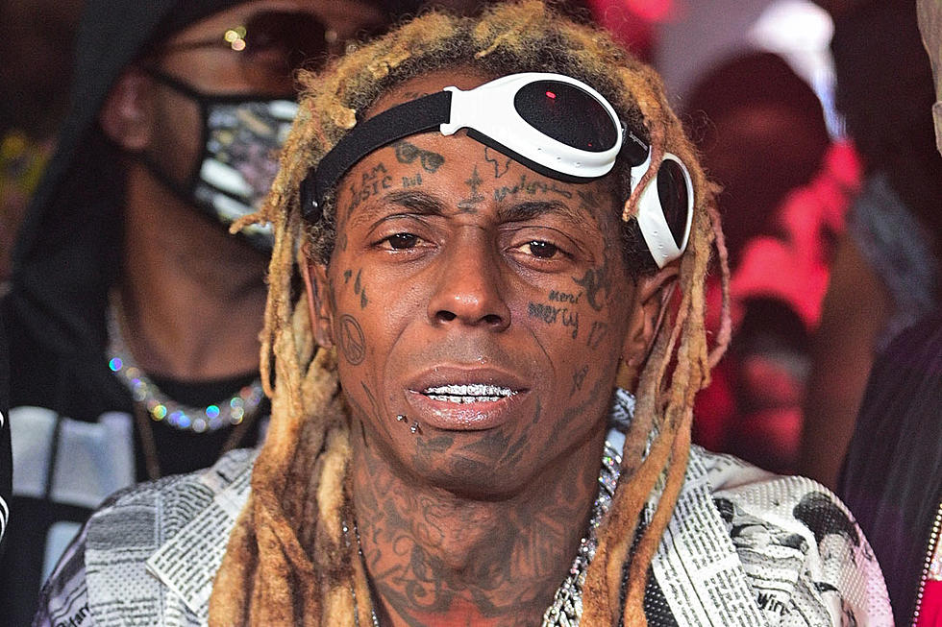
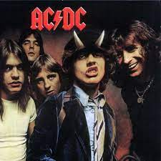
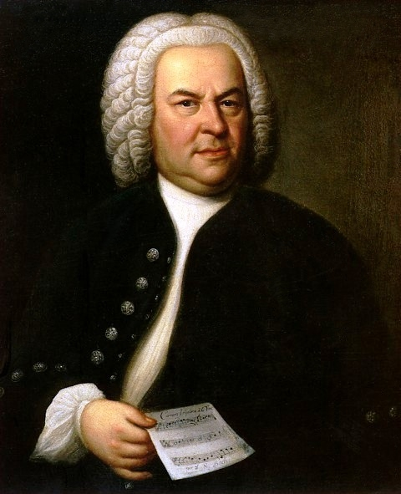
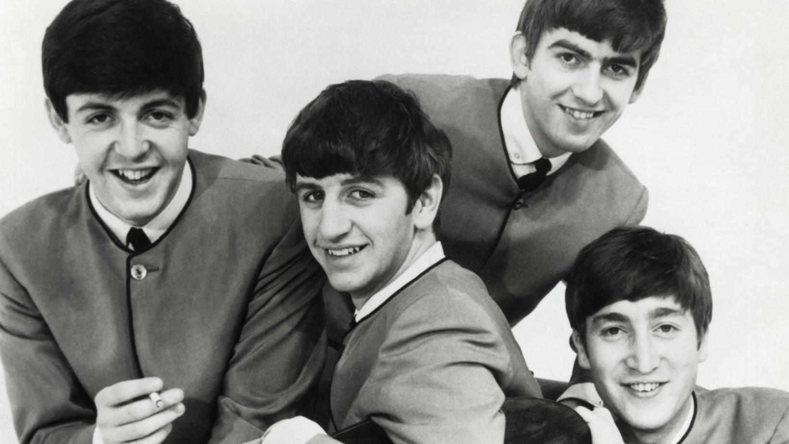
Spotify uses the parameters developed by Echo Nest
Non-standard variables do not have equations posted. Nobody will list specific information on their discussion boards
They may be proprietary
Instrumentalness is the most difficult to understand
Lil Wayne has song more instrumental than Bach
Some famous songs are surprisingly low

Slide 11
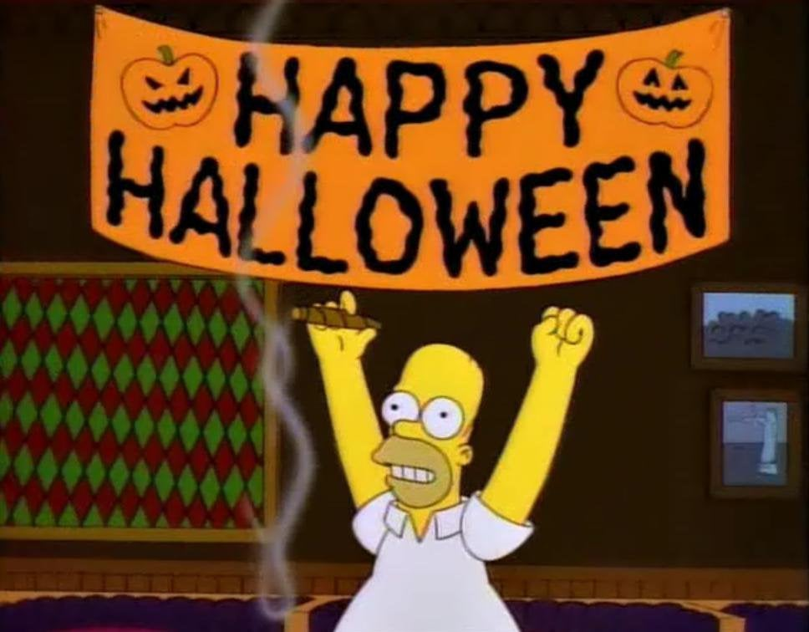
Popularity is based on total number of plays and how recent those plays occurred
Some songs are more popular at certain times of the year, for instance a holiday. If dataset is examined then, the data could be skewed.
This dataset was uploaded on January 24, so the most popular songs for 18 years are Christmas songs
Sia’s “Snowman” Christmas song is the most popular song of 2018
This year, I invested in pumpkins. They've been going up the whole month of October and I got a feeling they're going to peak right around January and, bang! That's when I'll cash in. - Homer Simpson

Slide 12
Radar Plots
Radar plots were created in Excel as part of initial examination
Because SQL was used, it was very easy to copy in results
Plot 1 – Most popular songs of 2020 (popularity tied)
Plot 2 & 3 – 10 most recent popular songs (ties included) and Most popular songs of the 1960s (ties included)
1960s was about 2 generations ago
Contains artist that are still very familiar today in Elvis Presley, Jimi Hendrix, The Beatles, and The Rolling Stones
Plot 4 – Most popular songs for a year that are Christmas themed

Slide 13
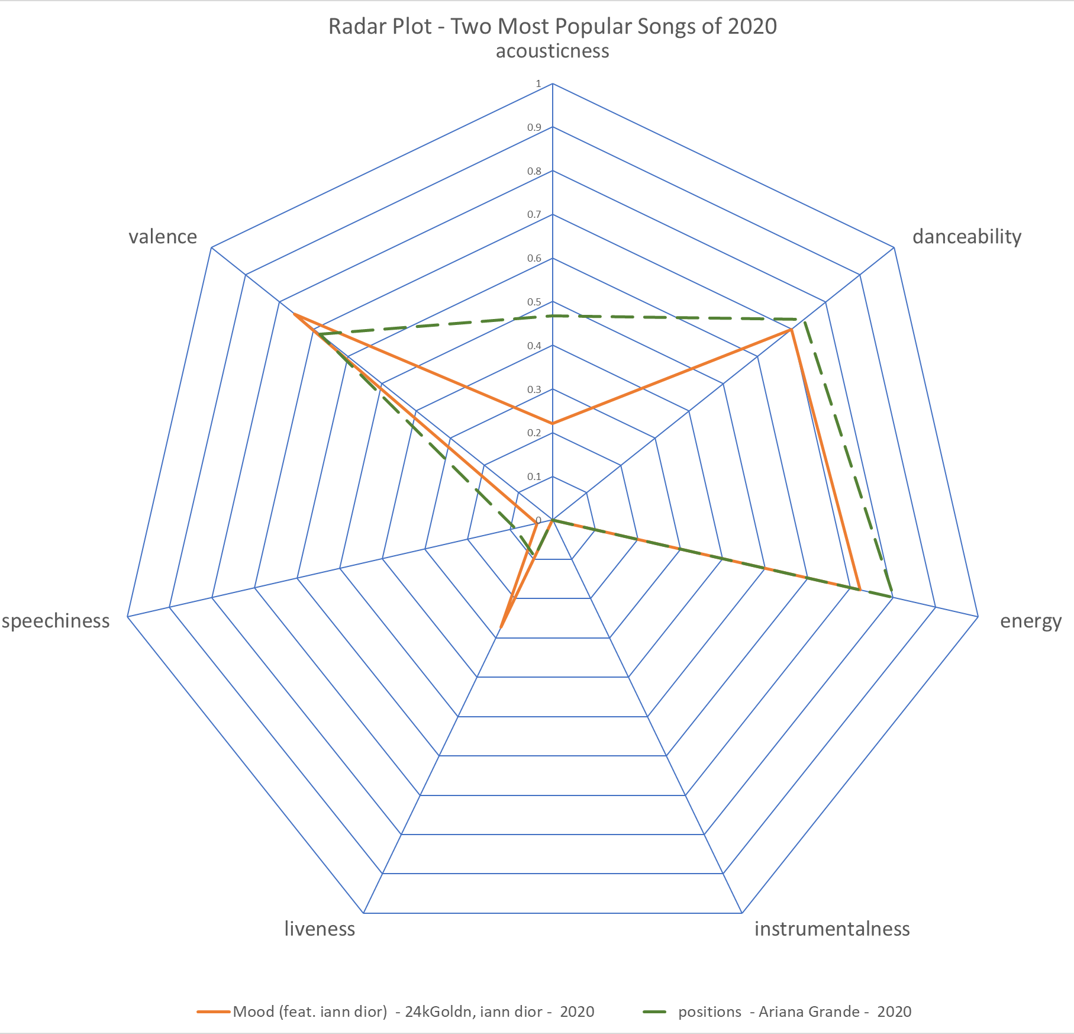
Similar variables
Positions
- Ariana is a pop singer
- More acoustic
Mood
- Album version
- Layering of sounds
may cause high liveness

Slide 14
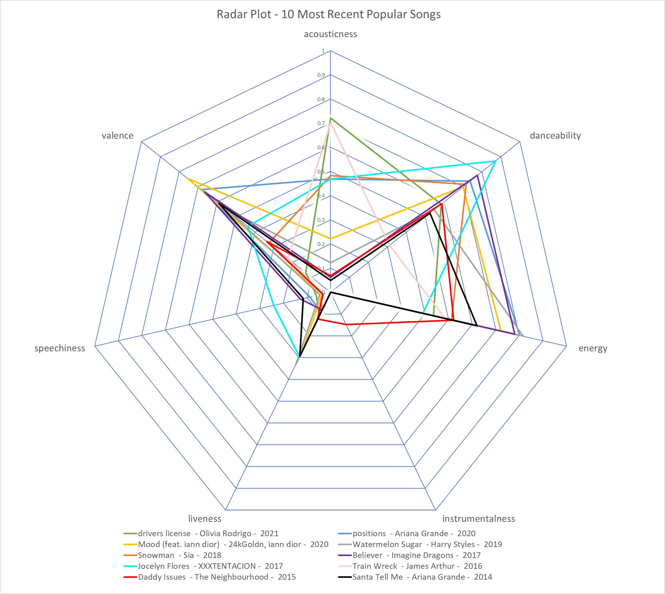
Current Music Less - Valence - Acousticness
- Liveness
More - Danceability - Energy
Similar - Instrumentalness
Some Songs have - Speechiness Highest Speechiness
Is by rapper

Slide 15
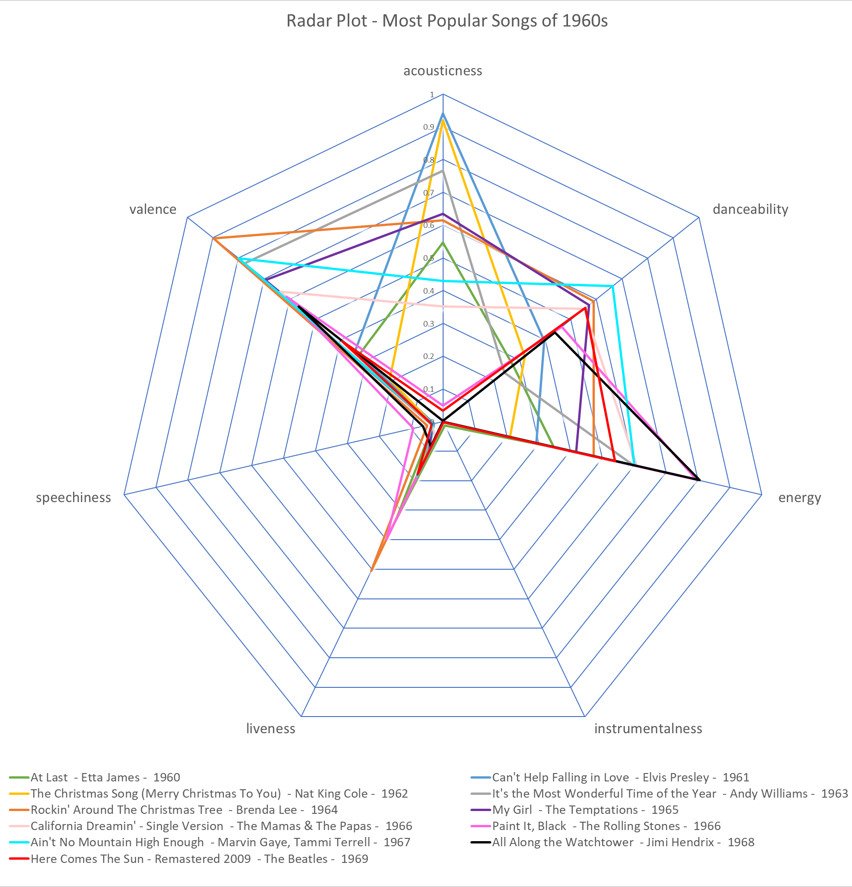
Current Music Less - Valence - Acousticness
- Liveness
More - Danceability - Energy
Similar - Instrumentalness
Some Songs have - Speechiness Liveness higher –
maybe sound mixing
improvements

Slide 16
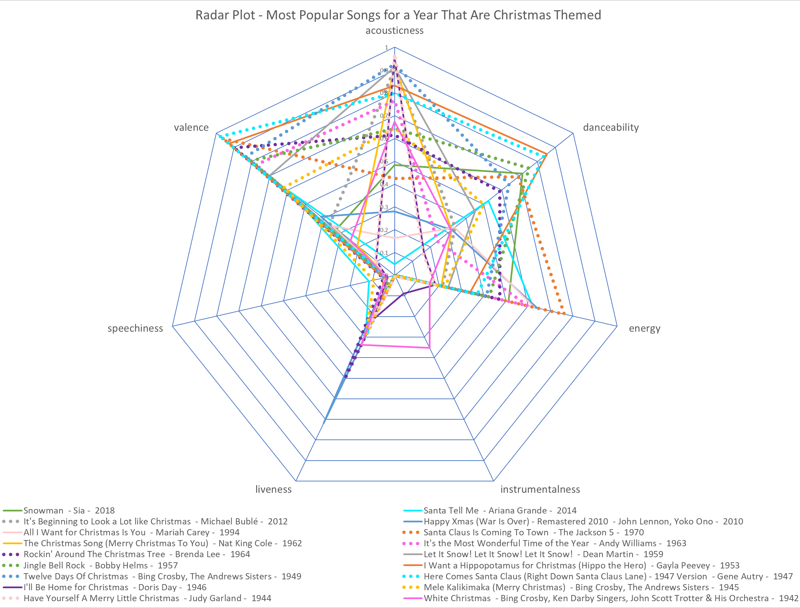
High
- Valence Average to High
- Danceability
- Energy
Older Songs
- Higher liveness
White Christmas
- High Instrumentalness
- “Ohh” and “Ahh” count as instrumentalness

Slide 17

Python Code
The code focused on three different aspects
Plotting histograms
Linear coefficient correlation
Regression – Random Forest

Slide 18
Histograms
The histograms for the variables in the dataset were created
The instrumentalness histogram shows most of the songs have near zero instrumentalness
Consistent with previous notes on instrumentalness variable
The popularity histogram shows that most of the songs have near zero popularity
The acoustic histogram shows most of the songs have 0 or 1.0 acousticness
The liveness histogram was right skewed and shows most songs do not have the presence of audience
The danceability histogram was the most normal histogram

Slide 19
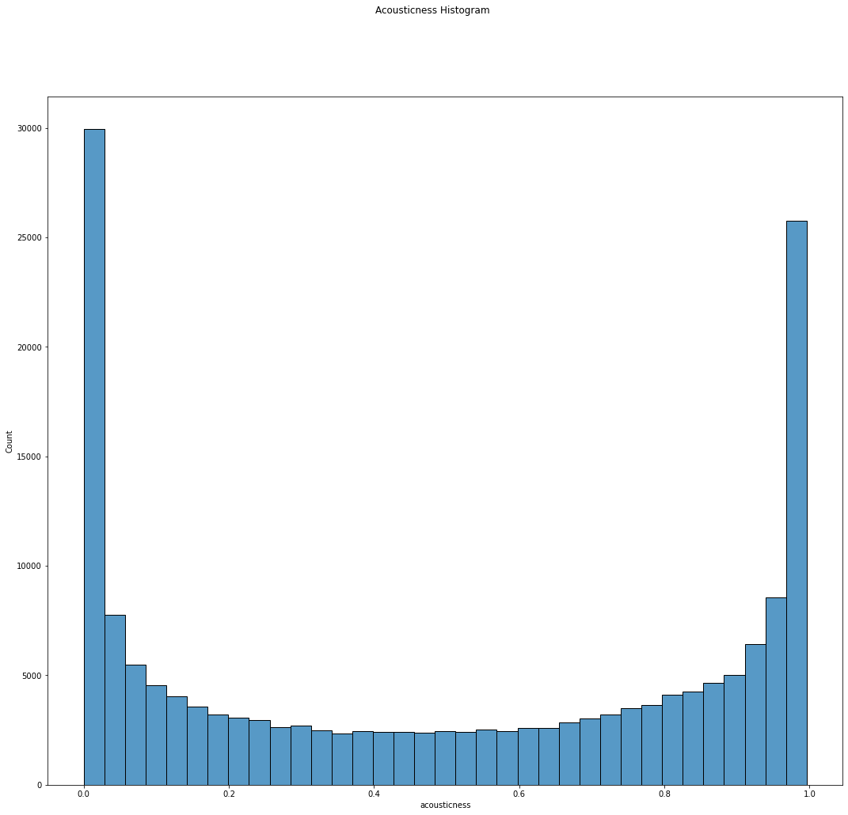

Slide 20
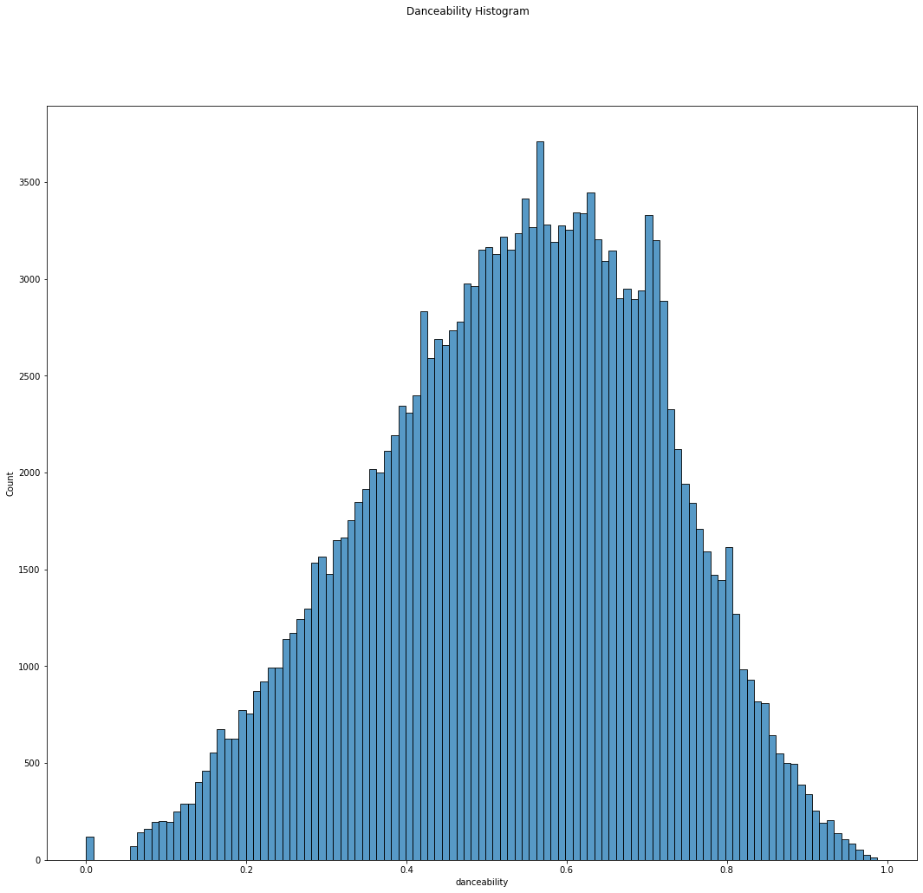

Slide 21
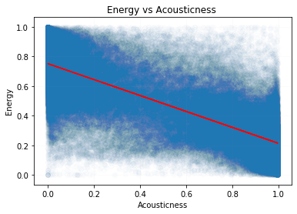
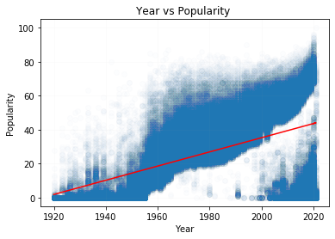


Linear Coefficient Correlation - 1
The linear correlation of energy vs acousticness of all the songs was calculated and plotted
The linear correlation of year vs popularity of all the songs was calculated and plotted

Slide 22
Linear Coefficient Correlation - 2
The linear correlation of the year vs the average variable for that year was plotted. The results for each calculations are below:
1.00 > Correlation > 0.75
Energy, loudness, popularity, tempo
0.75 > Correlation > 0.50
None
0.50 > Correlation > 0.00
Danceability
0.00 > Correlation > -0.50
Liveness, speechiness, valence
-0.50 > Correlation > -0.75
Instrumentalness
-0.75 > Correlation > -1.00
Acousticness
The graphs for the largest negative correlation (year vs average acousticness), largest positive correlation (year vs average energy), and smallest correlation (year vs average valence) are shown

Slide 23
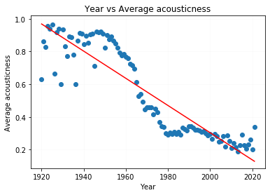
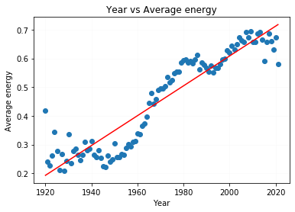
Correlation Coefficient for Year vs acousticness : -0.9066824615616447
Equation of the line: acousticness = -0.008 Year +(16.92)
Correlation Coefficient for Year vs energy : 0.9314491358333657
Equation of the line: energy = 0.005 Year +(-9.78)

Slide 24
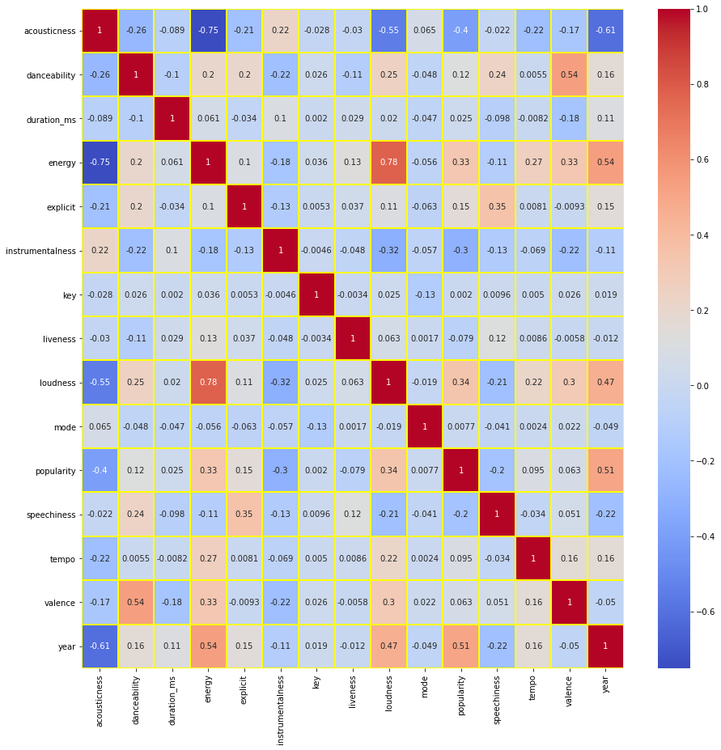
Heatmap
Red represents positive correlation, blue is negative correlation

Slide 25
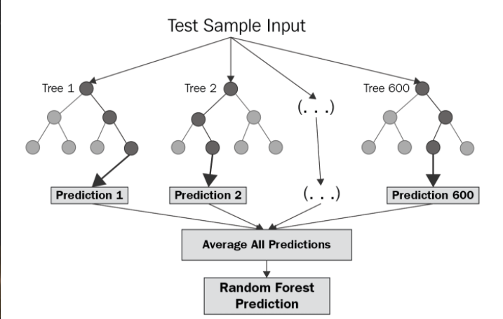
Regression – Random Forest
Why Random Forest Regression over Linear Regression?
Linear Regression is helpful when the data distribution follows a deterministic pattern
Since the observed data does not follow any such distribution, a linear regression model would produce a high bias
In such a case, non-parametric models such as Random Forest are usually helpful due to their low-bias characteristics
Since Random Forest models do not determine an equation based on train data and instead use a cluster of decision trees based on factor values, they are immune to high variance datasets and usually do well with non-deterministic predictor variables
Random Forest Model

Slide 26
Feature Selection
Through the process of variable selection for training, feature importance plot of the model predictors revealed that ‘Tempo’ & ‘Loudness’ contributed negligibly in predicting the response and hence were removed to reduce training time without impacting accuracy

Slide 27
Model Training Statistics
K-1 folds
Training
K-folds
K^{th} fold
Testing
No. of folds: 5
k = 1
RMSE: 0.289
MSE: 0.084
MAE: 0.256
k = 2
RMSE: 0.237
MSE: 0.056
MAE: 0.205
k = 3
RMSE: 0.226
MSE: 0.051
MAE: 0.193
k = 4
RMSE: 0.249
MSE: 0.062
MAE: 0.216
k = 5
RMSE: 0.193
MSE: 0.037
MAE: 0.154

Slide 28
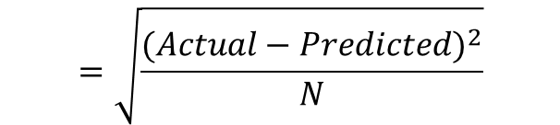


Results – Model Performance Statistics
Performance | Train Data | Test Data
RMSE (Root Mean Square Error) | 0.239 | 0.235
MSE (Mean Square Error) | 0.058 | 0.055
MAE (Mean Absolute error) | 0.205 | 0.198
$$=\sqrt{\frac{{(Actual−Predicted)}^{2}}{N}}$$
RMSE
MSE
MAE
The Performance Statistics across train and test datasets are similar revealing no over-fitting
Additionally, costs across the datasets are not very high thereby supporting ~80% as the average accuracy of the model (using MAE)
$$=\frac{{(Actual−Predicted)}^{2}}{N}$$
$$=\frac{|Actual −Predicted|}{N}$$

Slide 29
Conclusions
Spotify is one of the top worldwide music streaming services.
Using their API, it is possible to get a detailed look into music trends
Radar plots are a good way to show the evolution of music over time
Some of the variables produced questionable values
Some correlation was observed when examining the variables vs the year
Because the data did not exhibit a deterministic pattern, it was not advisable to use linear regression to predict popularity
Instead, Random Forest Modeling was used to try and create a methodology for predicting the popularity
The Random Forest Modeling was able to predict the popularity at 80% accuracy.

Slide 30
References 1
1) Company Info Spotify, 16 Mar. 2021, newsroom.spotify.com/company-info/. Accessed 03/26/2021. Accessed 03/26/2021.
2) “How Did Spotify Become the Number One Music Streaming Provider?” Performance Magazine How Did Spotify Become the Number One Music Streaming Provider Comments, www.performancemagazine.org/spotify-number-one-music-provider/. Accessed 03/26/2021. Accessed 03/26/2021.
3) Kumar, |By Abhilash. “Global Online Music Streaming Growth Slowed Down in Q2 2020.” Counterpoint Research, 6 Oct. 2020, www.counterpointresearch.com/global-online-music-streaming-growth-slowed-down-in-q2-2020/. Accessed 03/26/2021.
4) Spotify Usage and Revenue Statistics (2021). Business of Apps, 12 Mar. 2021, www.businessofapps.com/data/spotify-statistics/#5. Accessed 03/26/2021.
5) Where Is Spotify Available?. Spotify, 16 Mar. 2021, support.spotify.com/us/article/full-list-of-territories-where-spotify-is-available/. Accessed 03/26/2021.
6) Soper, Taylor. “Spotify Becomes First Music Platform to Integrate with Facebook Messenger.” GeekWire, 3 Mar. 2016, www.geekwire.com/2016/spotify-becomes-first-music-platform-integrate-facebook-messenger/. Accessed 03/26/2021.
7) Soper, Taylor. “Amazon Echo Can Now Play Music from Spotify for Premium Users.” GeekWire, 4 Feb. 2016, www.geekwire.com/2016/amazon-echo-can-now-play-music-spotify-premium-users/. Accessed 03/26/2021.
8) Web API. Spotify, developer.spotify.com/documentation/web-api/. Accessed 03/26/2021.

Slide 31
References 2
9) Ay, Yamac Eren. Spotify Dataset 1921-2020, 160k+ Tracks. Kaggle, 24 Jan. 2021, www.kaggle.com/yamaerenay/spotify-dataset-19212020-160k-tracks. Accessed 03/26/2021.
10) Web API Reference. Spotify for Developers, developer.spotify.com/documentation/web-api/reference/. Accessed 03/26/2021. Accessed 03/26/2021.
11) Pitch (Class). Open Music Theory, 2018, openmusictheory.com/pitch(Class).html. Accessed 03/26/2021.
12) The Echo Nest. Wikipedia, 27 Jan. 2021, en.wikipedia.org/wiki/The_Echo_Nest#cite_note-fast_company-6. Accessed 03/26/2021.
13) Lunden, Ingrid. Spotify Acquired Music Tech Company The Echo Nest In A $100M Deal. TechCrunch, 7 Mar. 2014, techcrunch.com/2014/03/07/spotify-echo-nest-100m/. Accessed 03/26/2021.
14) Eagles Discography. Wikipedia , 21 Feb. 2021, en.wikipedia.org/wiki/Eagles_discography. Accessed 03/26/2021.
15) Nirvana Discography. Wikipedia , 10 Mar. 2021, en.wikipedia.org/wiki/Nirvana_discography. Accessed 03/26/2021.
16) Valence as a Measure of Happiness. Spotify, 11 Feb. 2018, community.spotify.com/t5/Spotify-for-Developers/Valence-as-a-measure-of-happiness/td-p/4385221. Accessed 03/26/2021
17) How Does Spotify Estimate the Valence of a Song? Quora, www.quora.com/How-does-Spotify-estimate-the-valence-of-a-song. Accessed 03/26/2021.

Slide 32
Images References in PowerPoint
1) “Web Player: Music for Everyone.” Spotify, open.spotify.com/. Accessed 03/26/2021.
2) Industria Musical. The Echo Nest Se Asocia Con Getty Images. 30 Dec. 2013, industriamusical.es/the-echo-nest-se-asocia-con-getty-images/. Accessed 03/26/2021. Accessed 03/26/2021.
3) Adams, Scott. “Dilbert Comic Strip on May 07, 2014.” Dilbert, 7 May 2014, dilbert.com/strip/2014-05-07. Accessed 03/26/2021.
4) Woods, Aleia. Lil Wayne Pleads Guilty to Federal Firearm Charge, Faces Prison Time. XXL, 11 Dec. 2020, www.xxlmag.com/lil-wayne-pleads-guilty-federal-firearm-charge/. Accessed 03/26/2021.
5) AC/DC: Highway to Hell. IMDb, www.imdb.com/title/tt6966694/. Accessed 03/26/2021.
6) Johann Sebastian Bach. Encyclopædia Britannica, Inc., 17 Mar. 2021, www.britannica.com/biography/Johann-Sebastian-Bach. Accessed 03/26/2021.
7) McPhate, Tim. “Remember When? Beatles' ‘I Want To Hold Your Hand.’” GRAMMY.com, Recording Academy, 27 Aug. 2020, www.grammy.com/grammys/news/remember-when-beatles-unleash-i-want-hold-your-hand. Accessed 03/26/2021.
8) “Homer vs. Patty and Selma/Gallery.” Simpsons Wiki, simpsons.fandom.com/wiki/Homer_vs._Patty_and_Selma/Gallery. Accessed 03/26/2021.

